Slide 1

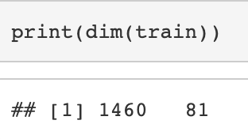

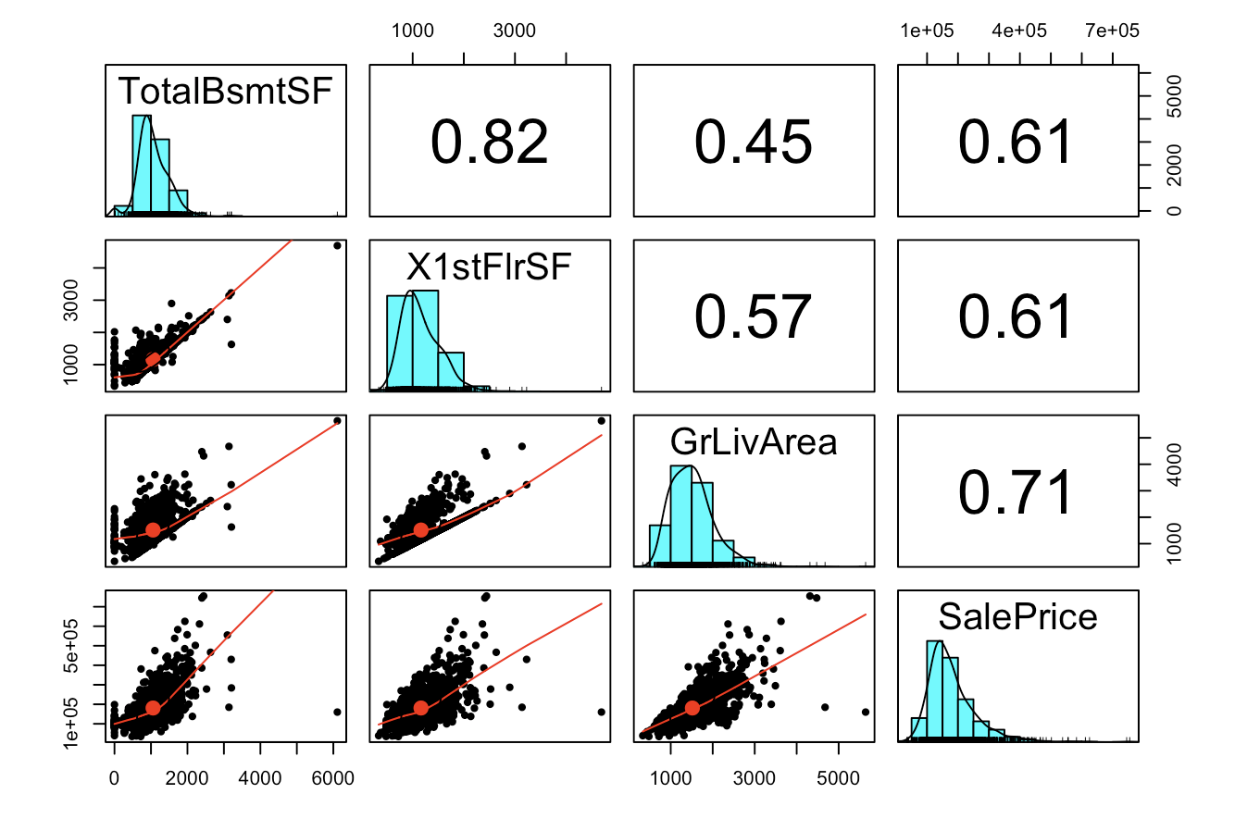
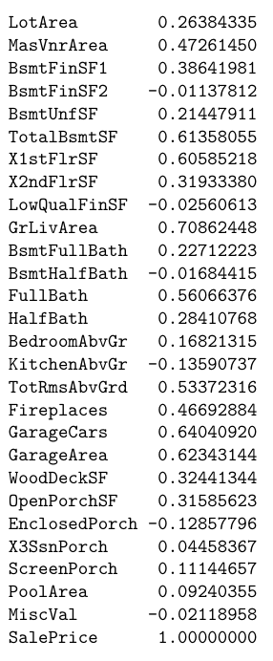
House Price Prediction
An accurate prediction of the housing price
Feature Selection
LASSO
/
R
I
DGE
Collinearity
Problem
PLS
/
PCR

Slide 2
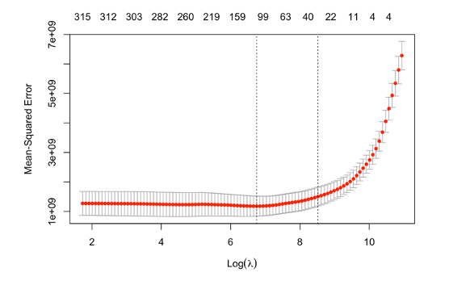
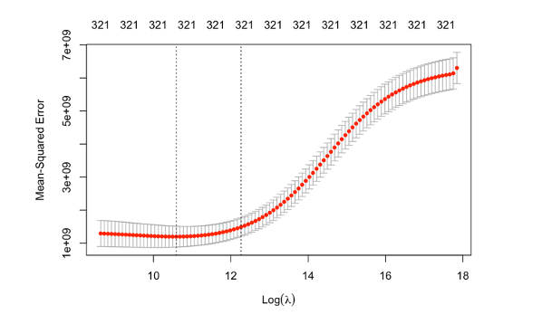
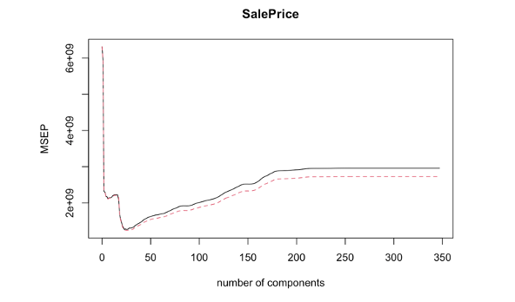
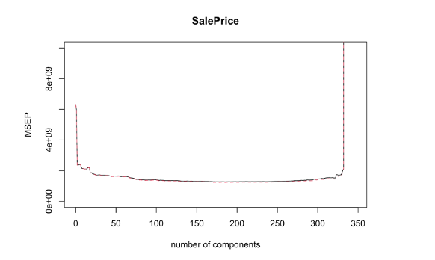
Model Analysis
LASSO
Ridge
PCR
PLS

Slide 3
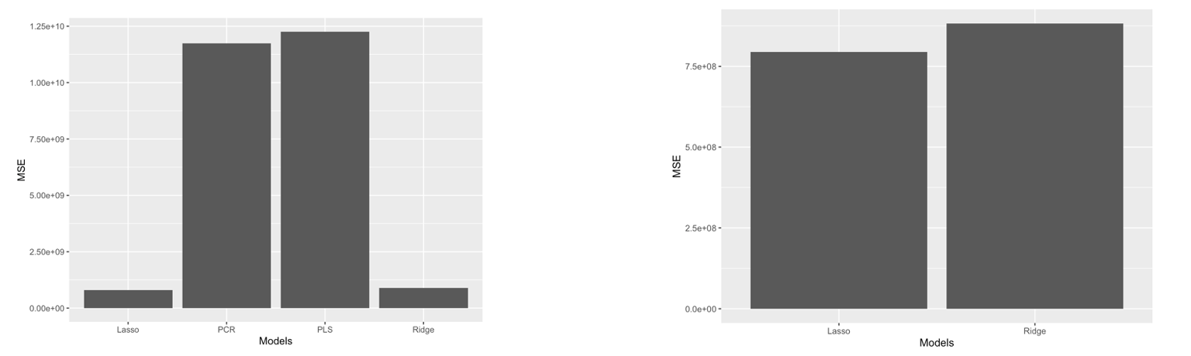
Models Comparison - MSE
(1) PLS and PCR has comparably similar MSE, while Lasso and Ridge Regression has comparably similar MSE.
(2) Lasso and Ridge Regression’s MSE much smaller than PLS and PCR’s MSE.
(3) Lasso has the lowest MSE value.

